Slide 1


Cab Transaction Using Facial Recognition and Matching Engine
Aldel Education Trust’s
St. John College of Engineering and Management, Palghar
NAAC Accredited with Grade A (2017-2022)
Department of Computer Engineering
Rohan Chavan, (EU1152082), (B), ()
Kshitij Shukla , (EU2152053), (B), (47)
Saniket Patl (EU2152014), (B), (33)
Mr. Vivian Lobo
(Project Guide)
April 2020

Slide 2
CONTENTS
Abstract
Introduction
Problem Statement
Objective
Scope
VGG
Requirement
Design(Activity Diagram)
Conclusion
References

Slide 3
Abstract
The transactions with either cash, card, UPI, E-wallet etc. Sometimes these methods are not hassle free. Therefore, a new system has been proposed for transactions, where face scan method will be used.
The system in the cab will calculate the fare based on the distance and then it will authenticate the riders face and transact via connected central database
If the user’s input image matched with the trained dataset image then the User Profile and Transaction details gets loaded, and the subsequent trip details gets stored in the User Profile database.
The database is connected to frame web server.

Slide 4
Introduction
With the popularity in India of mobile payment platforms such as Paytm and PhonePe, QR codes can be found almost anytime, anywhere in Indian daily life.
As long as you have a mobile payment set up on your phone, you can virtually always go cashless in India.
QR codes are just a step in the evolution of mobile payment technology and they may soon be a thing of the past. In fact, soon people in India may be able to forget about QR codes, and pay with virtually nothing but their face.

Slide 5
Problem Statement
Today’s online transactions are not convenient for users to enter long high security passwords every time they want to make a transaction or remember their UPI VPA(Virtual Private Address), or even carry credit cards or debit cards everywhere. That’s highly inconvenient to the users. So, system are proposing a system where system don’t have to carry cards or remember your VPAs.

Slide 6
Objective
To design real time face recognition system for cabs transactions.
To design a system where face can be used for logging into profile.
To design a system for cabs where face detection system can also be used to pay along with card or cash.
To design a System where once your load your profile system can initiate a transaction without any card.
To design a secure system for cab transaction using facial recognition technique.

Slide 7
Scope
Improving facial recognition accuracy using as less user images as possible. Security of the payment gateway engine, easy user interface.

Slide 8
Requirement Analysis
Requirement analysis results in the specification of software’s operational characteristics indicates software’s interface with other system elements and establish constraints that soft- ware must meets.
The requirements analysis task is a process of discovery, refinement, modeling and Specification. Model of the required data, information and control flow and operations Behavior are created.
Functional Requirements:
  Functional requirements define the internal workings of the software: that is, the technical details, data manipulation and processing and other specific functionality that show how the use cases are to be satisfied.
  They are supported by non-functional requirements, which impose constraints on the design or implementation.

Slide 9
Software and Hardware Requirement
    Hardware Requirements
Internet Connectivity.
Web Camera
Storage Space: Minimum 32 GB free; Recommended 64 GB or more
Memory (RAM): Minimum 4 GB; Recommended 8 GB or above
Software Requirements
Python 3.x
Django
Django Rest Framework
Bottle Server
Postman
Sqlite Database
OpenCV

Slide 10
Non-functional Requirements
  Non – Functional Requirements
As the name suggest these are the requirements that are not directly interacted with specific Functions delivered by the system.
Functionality: This software will deliver on the functional requirements.
Flexibility: It provides the users to draw the log in easily.
Learn ability: The software is very easy to use and reduces the learning work.

Slide 11
Design
Designing basically refers to developing the various designs and diagrams, that are required to implement a project.
This chapter focus on the various diagrams that are developed as a part of proposed system and give their short description.
UML diagrams used are Activity diagram, E-R diagram, DFD diagram.

Slide 12
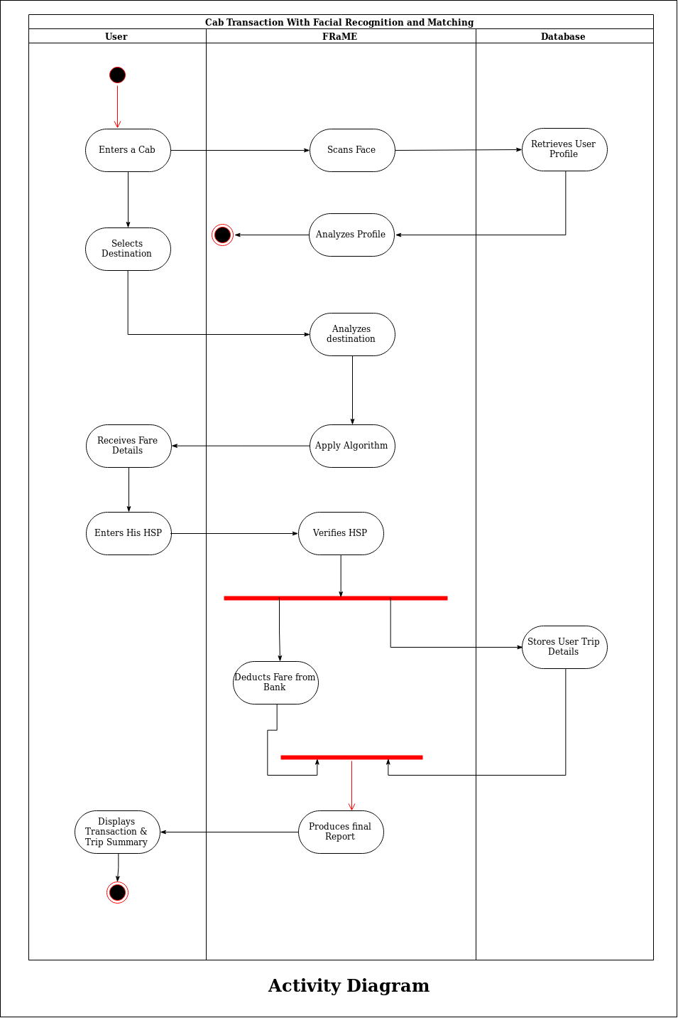
Activity Diagram

Slide 13
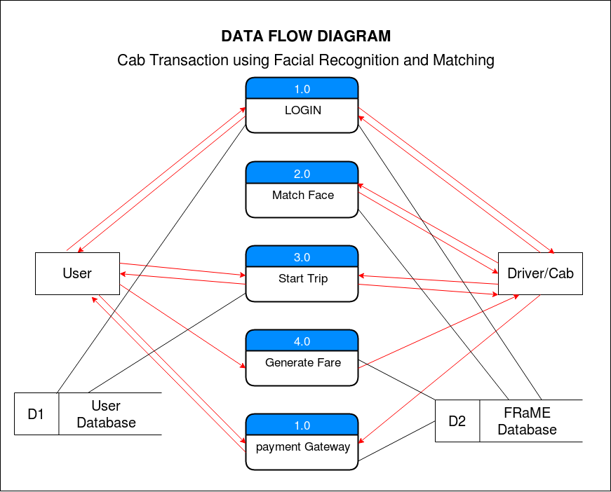
Data Flow Diagram

Slide 14
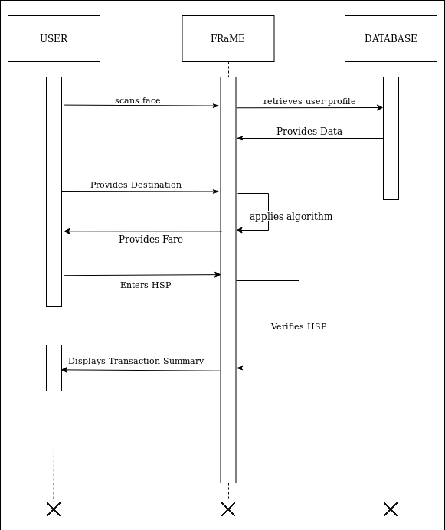
Sequence Diagram

Slide 15
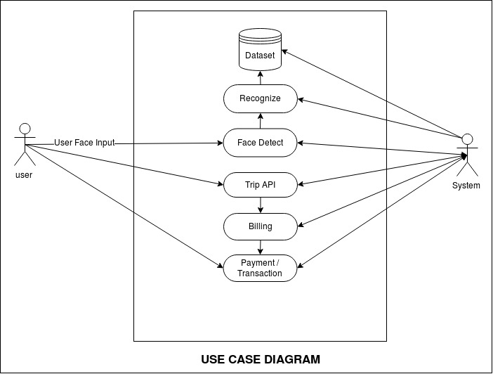
Use Case

Slide 16
Report on the Present Investigation
Proposed System
The proposed system involves automated cashless payment system using facial recognition. This system will work as an API between the payment system and any other application in which face of the user can be used for authentication.
Using this system, the user can directly pay fares for the cab rides or hotel stay etc.
This dataset of images will be used to train our facial recognition model powered by OPENCV, Local Binary Patterns Histograms Face Recognizer (LBPH) algorithm.
After the complete registration process, the user can login into the system by using facial recognition, and selects the destination.

Slide 17
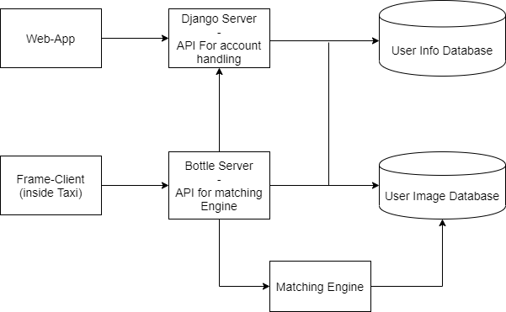
Architecture Diagram

Slide 18
Conclusion
The project is an advanced system which follows microservice architecture based on server client as well as web infrastructure. All the services are interconnected and use REST API for interprocess request/response communication. Account management is done using an API built with Django Rest framework, Bootle server acts as an communication unit with the matching engine which uses opencv LBHP ( local binary histogram pattern) to recognize the images which are stored in the user image database.

Slide 19
References
R.Prema, Dr. P.Shanmugapriya., et al. "A Face Recognition Techniques for Differentiate Similar Faces and Twin Faces." International conference on Energy, Communication, Data Analytics and Soft Computing (ICECDS 2017).
Falaye Adeyinka Adesuyi, Osho Oluwafemi, Alabi Isiaq Oludare, Adama Ndako and Amanambu Victor Rick. "Secure Authentication for Mobile Banking Using Facial Recognition." IOSR Journal of Computer Engineering (IOSR-JCE) e-ISSN: 2278-0661, p- ISSN: 2278-8727 Volume 10, Issue 3 (Mar. - Apr. 2013), PP 51-59 “www.iosrjournals.org”.
Surekha.R.Gondkar, Saurab. B, Dr. C.S.Mala. "Biometric Face Recognition Payment System”. International Journal of Engineering Research & Technology (IJERT). Special Issue – 2018, ISSN: 2278-0181, Volume 6, Issue 13 “Published by www.ijert.org”.
Face Recognition Using OpenCV and Python. [Online] Available: “https://www.superdatascience.com/blogs/opencv-face-recognition”. [Accessed: September 9,2019].
Microsrvices.io ‘AboutMicroservices.io’[Online]. Available: “https://microservices.io/”
Django ‘Meet Django’ [Online].Available: “https://www.djangoproject.com/”
Rest API ‘REST API Tutorial’ [Online].Available: “https://restfulapi.net/”
Django Rest Framework‘Django REST framework’ [Online]. Available: “https://www.django-rest-framework.org/”

Slide 20
Thank You !!!

